Slide 1

Candy Stock Management Application Presentation
By Ramanujam Kudiyarasan

Slide 2
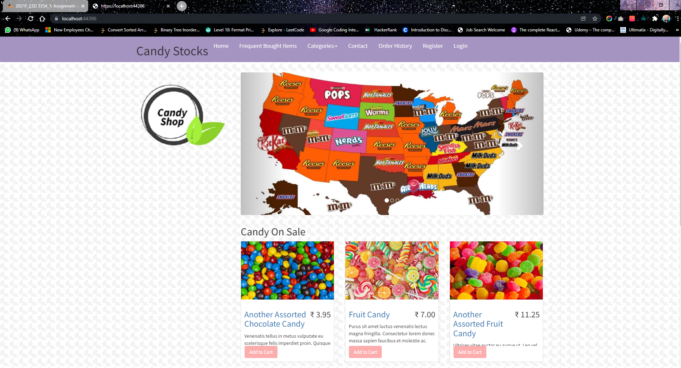
Welcome Page
This is the page user sees upon entering

Slide 3
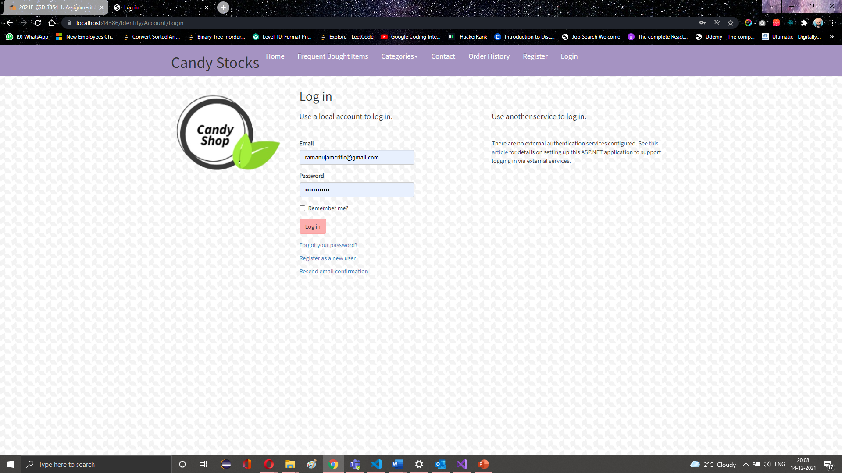
Login Page
Upon Clicking login button on the right corner, user will be redirected to this page
Existing users can use this page to login to the application to see what they have ordered or to make a new order

Slide 4
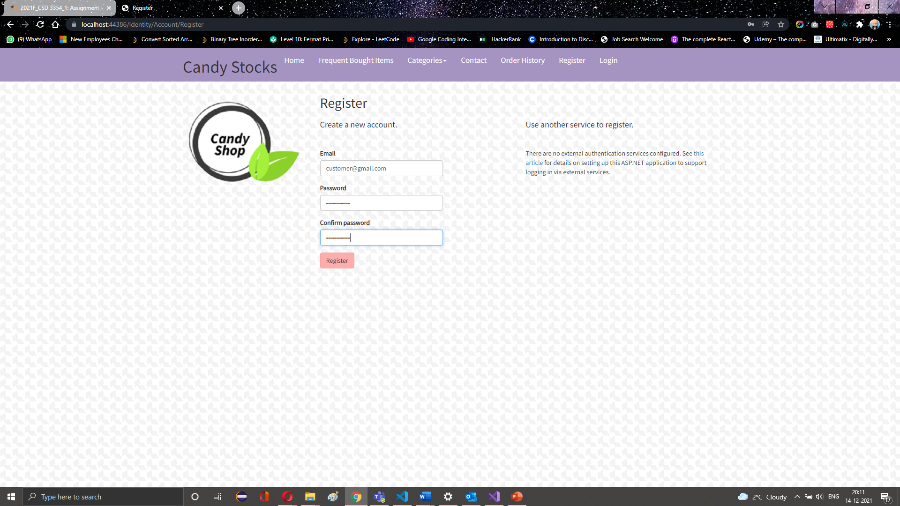
Register Page
Upon Clicking register button on the right corner, user will be redirected to this page
New users can use this page to login to make a new order

Slide 5
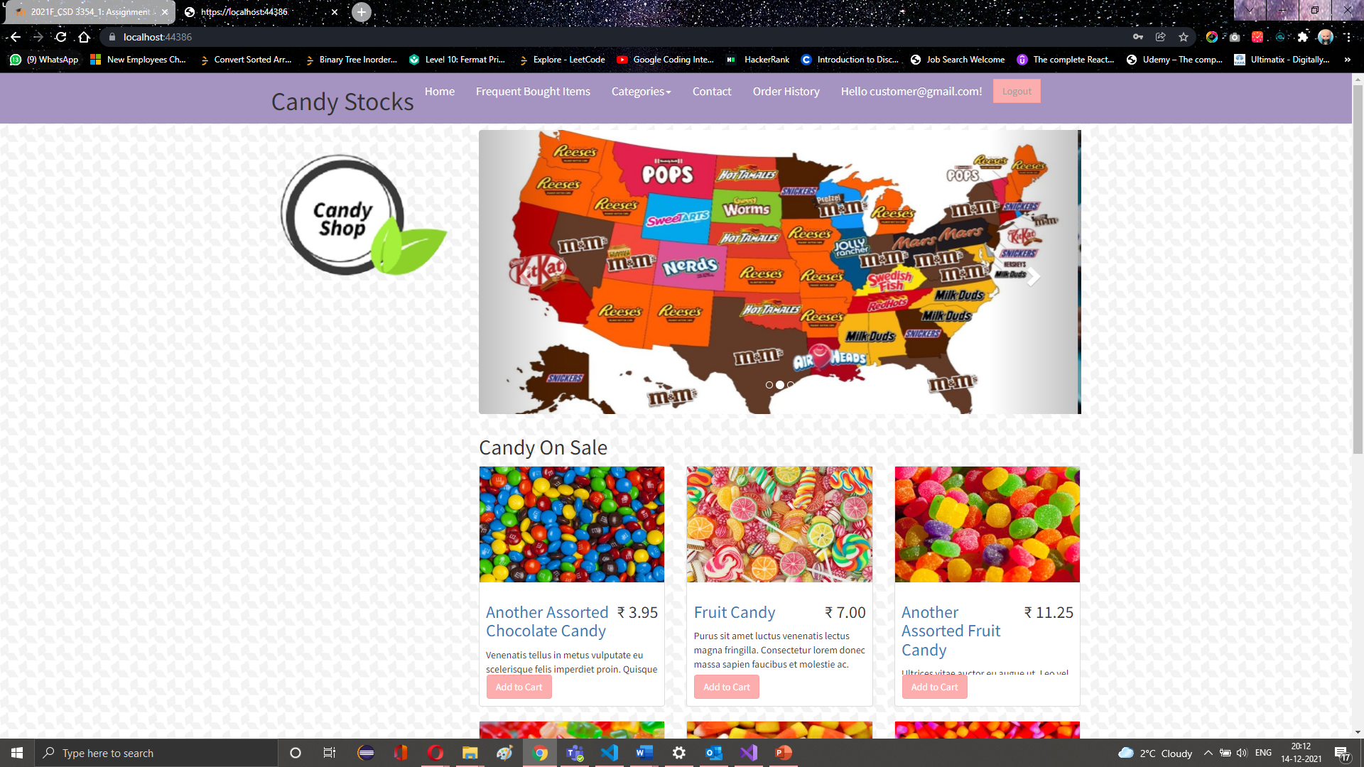
Home Page
The user sees list of items that are on sale, user can click the add to cart button to add it to cart and check it out

Slide 6
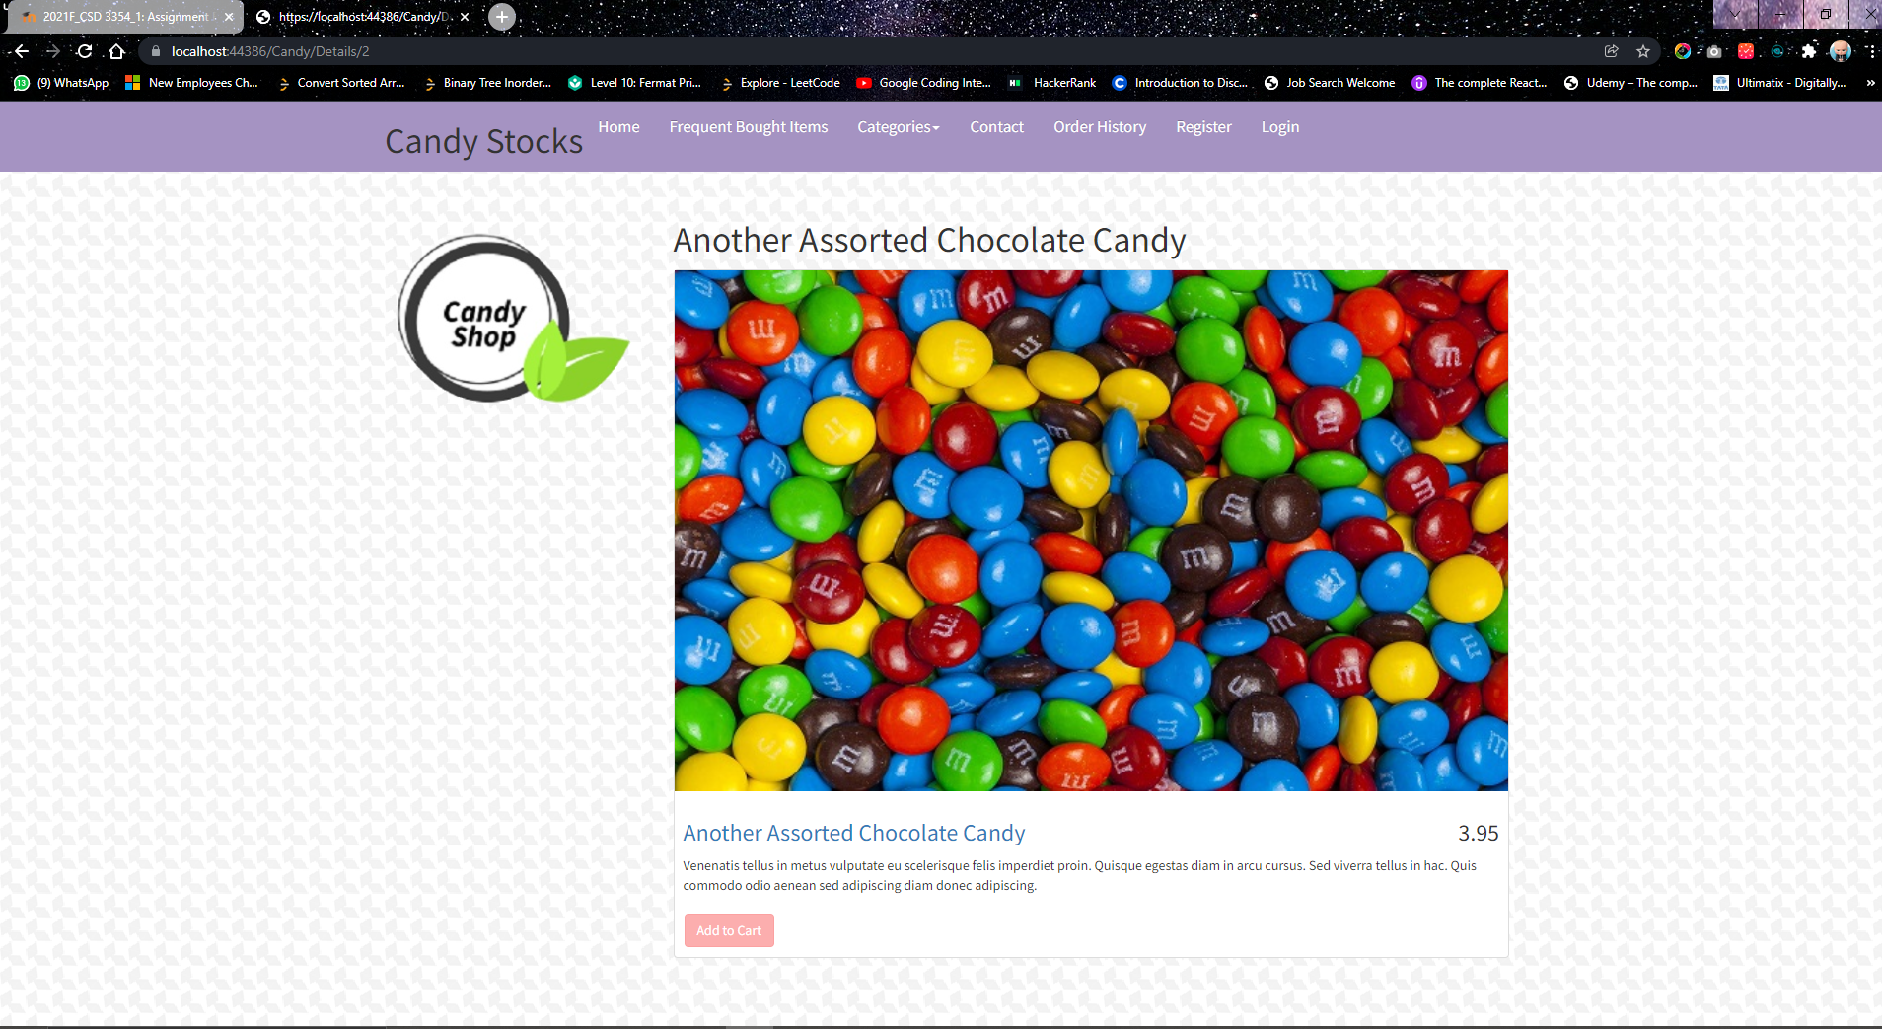
Product details
Upon Clicking the products, users shall eb able to see its details

Slide 7
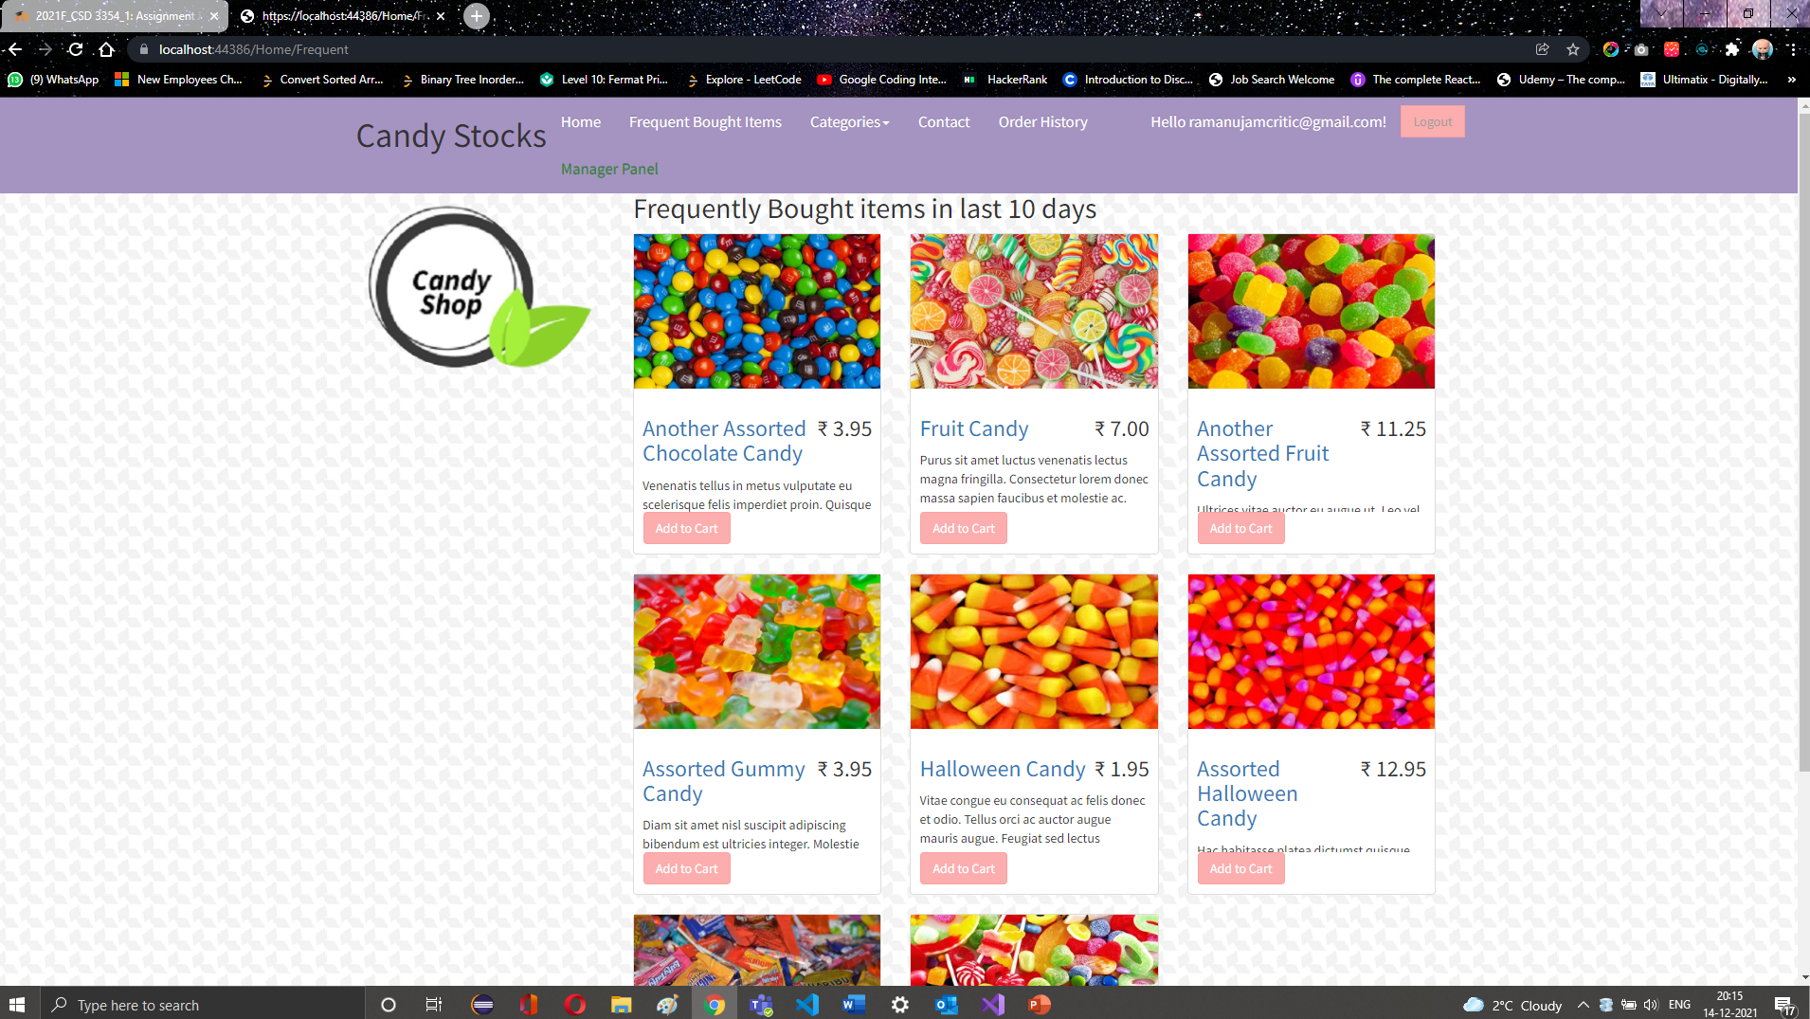
Frequently Bought ITem
The user sees list of frequently bought items in the last 10 days by clicking on the second option in the header

Slide 8
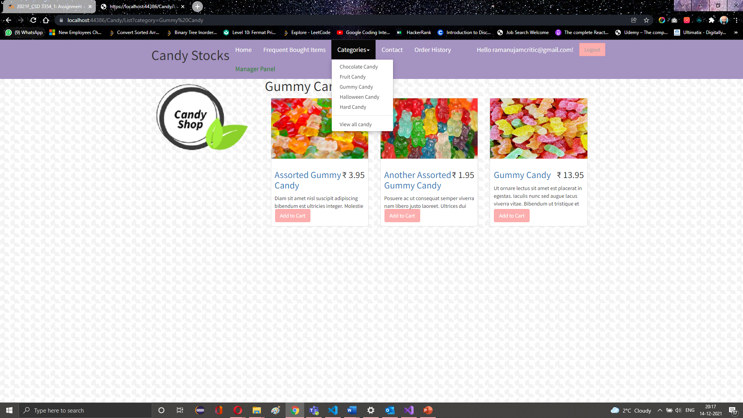
Category
The user may choose to see a particular category by choosing the category option given in header
Only the items that fall under that category shall be displayed

Slide 9
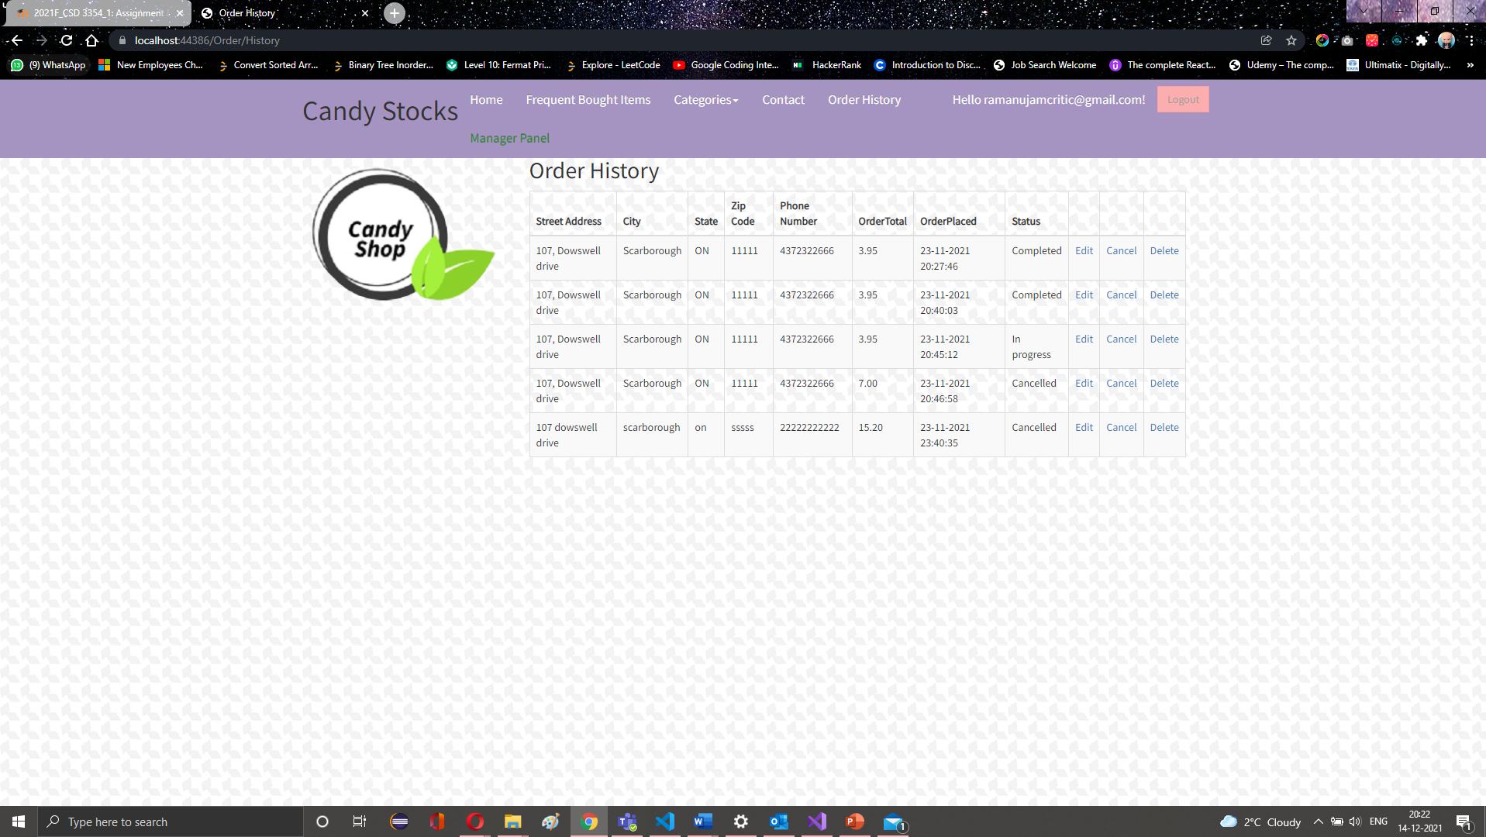
Order History Page
Users shall be able to view the previously ordered history and their statuses
Users shall have the option to edit, cancel and delete the orders from this page

Slide 10
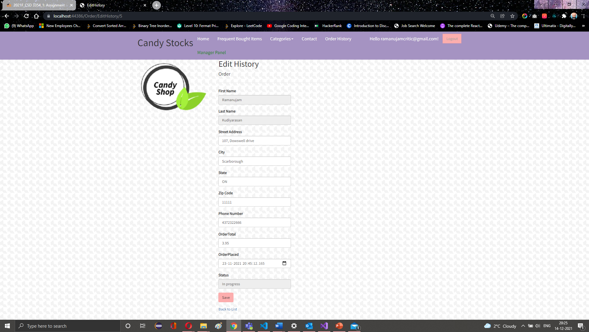
Order History -> Edit Order
Users shall be able to edit the orders that they have previously made

Slide 11
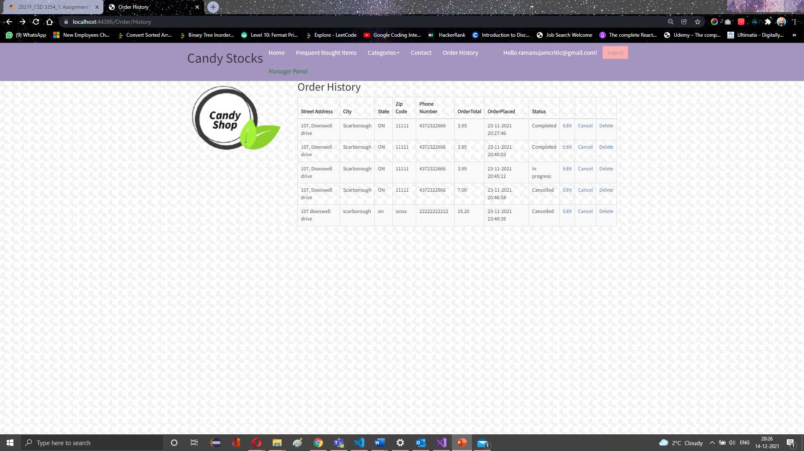
Order History -> Cancel Order
Users shall be able to cancel the orders that they have previously made

Slide 12

Order History -> Delete Order
Users shall be able to delete the orders that they have previously made

Slide 13
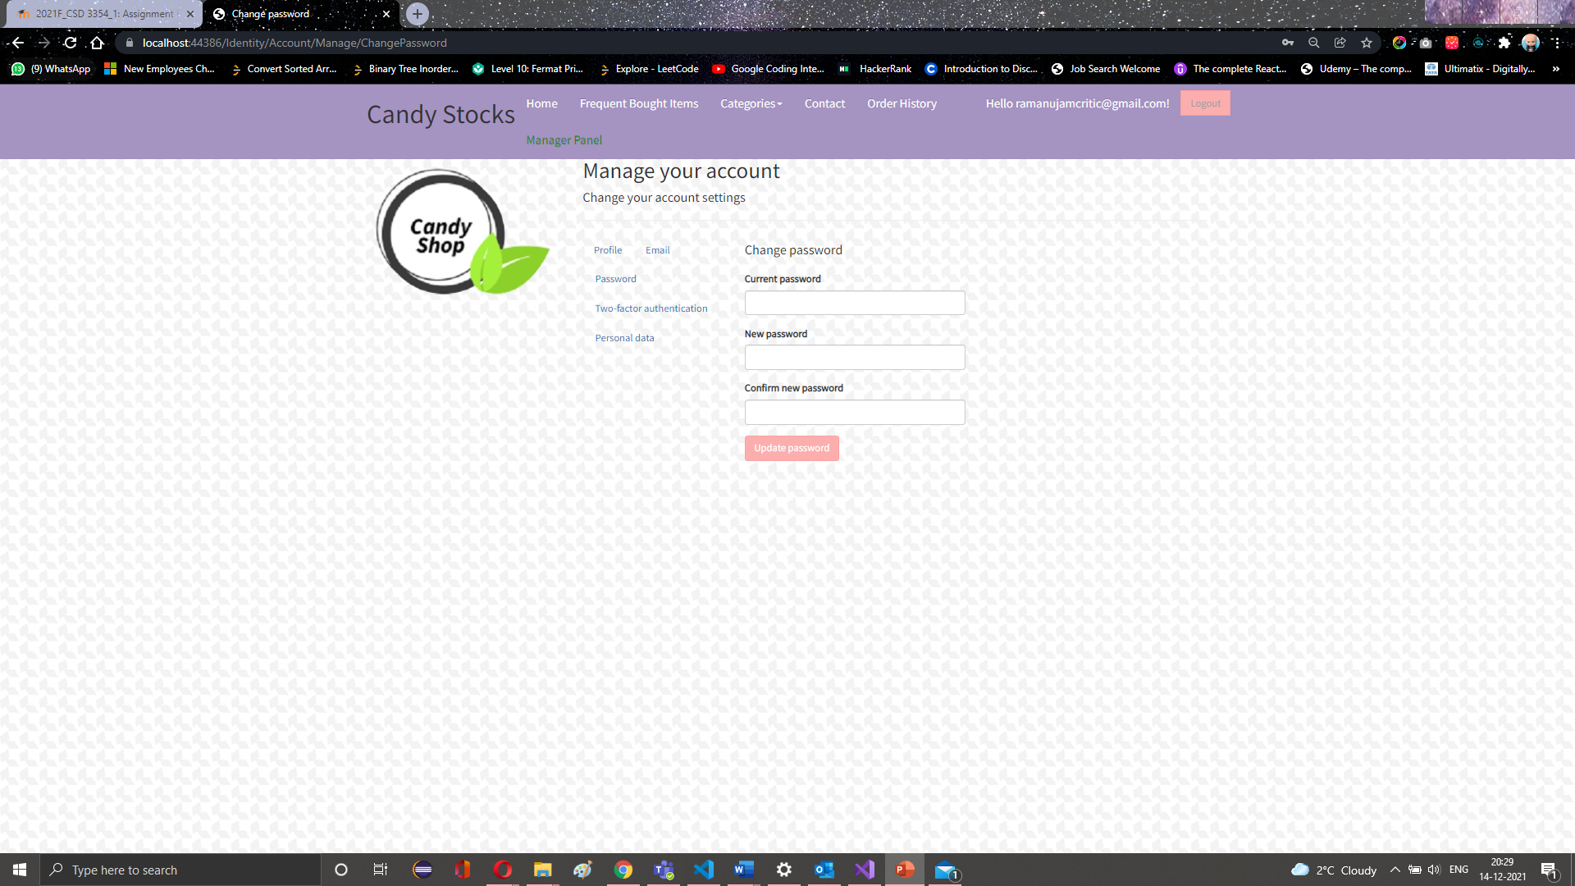
Manage Account Page
Users shall go to their account page by clicking their name displayed in the header
Users shall be able to change passwords, edit phone numbers, enable two factor authentication from this page

Slide 14
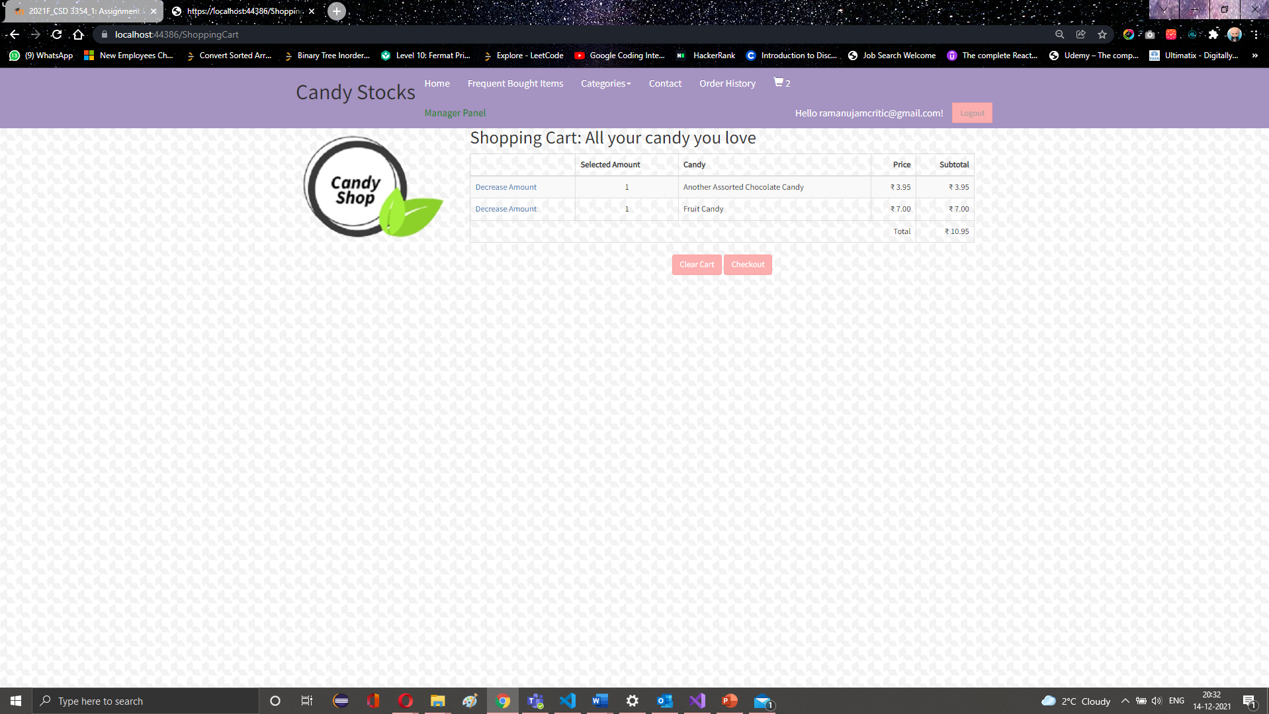
Shopping Cart Page
Users shall be able to select various products and add to the shopping carts before checking it out.
In this page, the user shall be able to checkout the cart items or to cancel the cart items or edit the quantity of items.

Slide 15
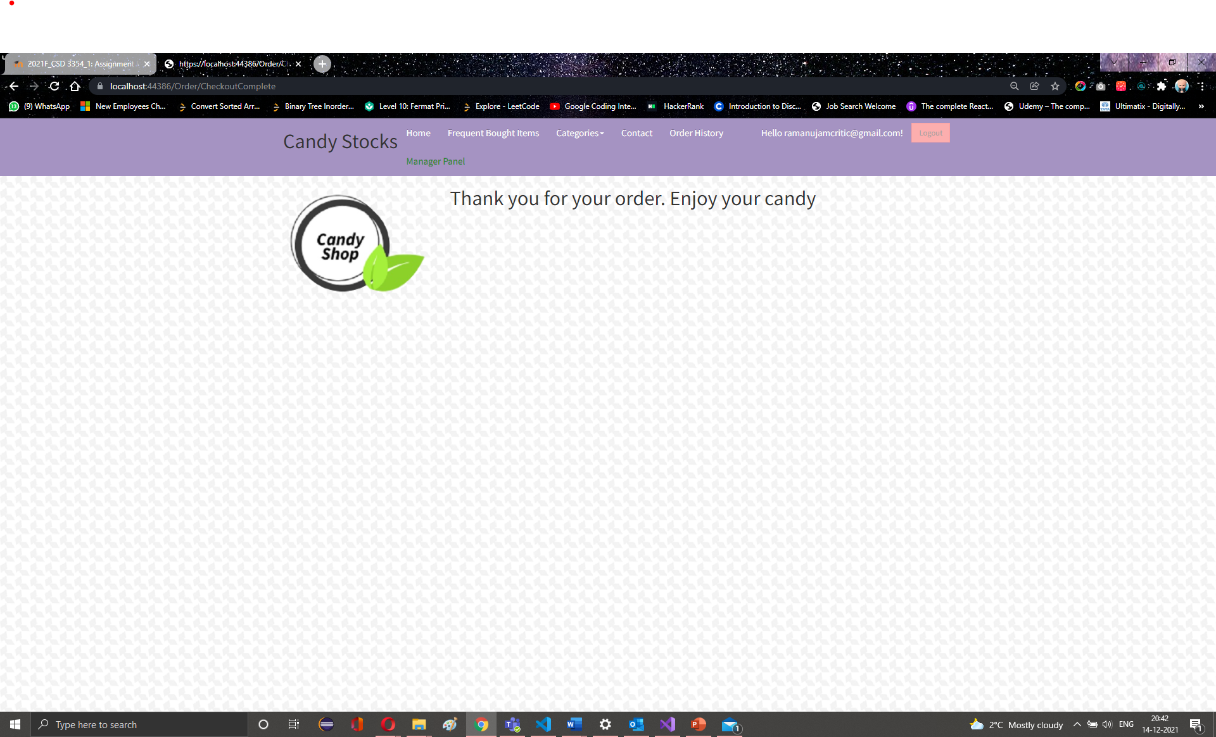
Shopping Cart Checkout -> Shopping Completed
Users shall go to their account page by clicking their name displayed in the header
Users shall be able to change passwords, edit phone numbers, enable two factor authentication from this page

Slide 16
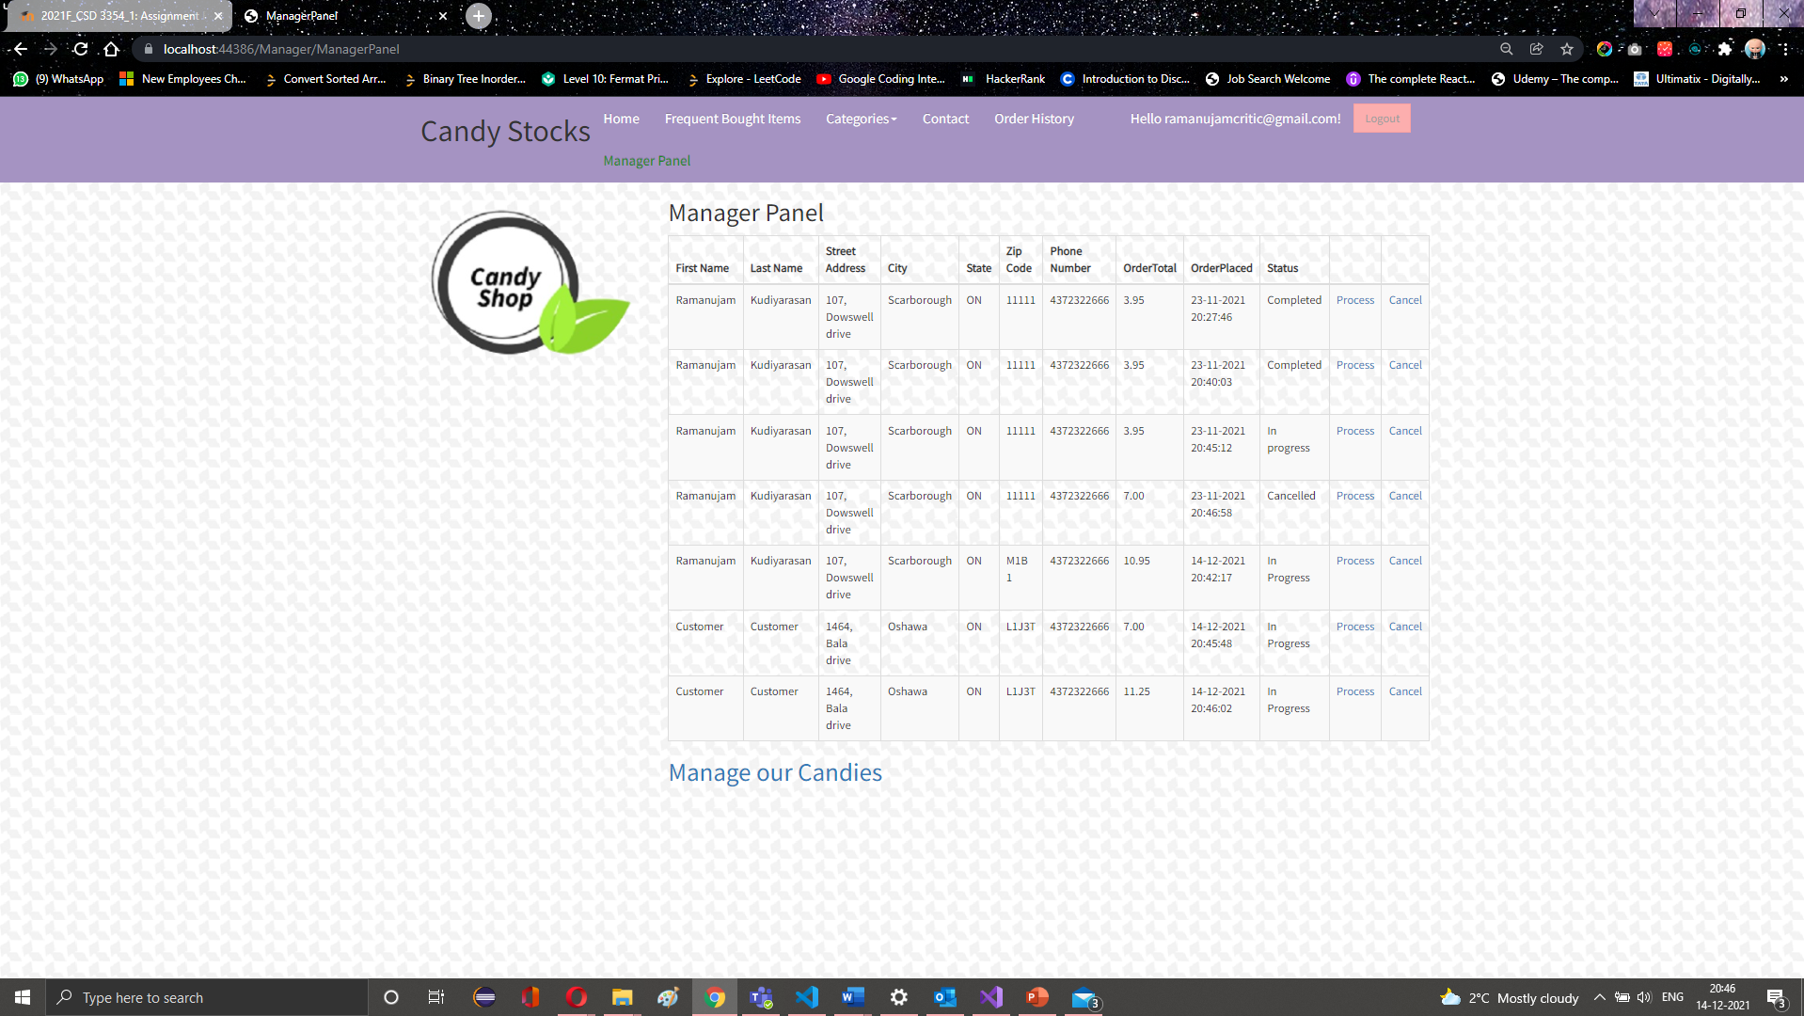
Admin Panel -> Order Processing
Admin user or manager user shall be able to view all the orders from all the users and will be able to process the orders or cancel the orders
Once the order is processed, the status changes to processed and if the order is cancelled then the status changes to cancelled

Slide 17
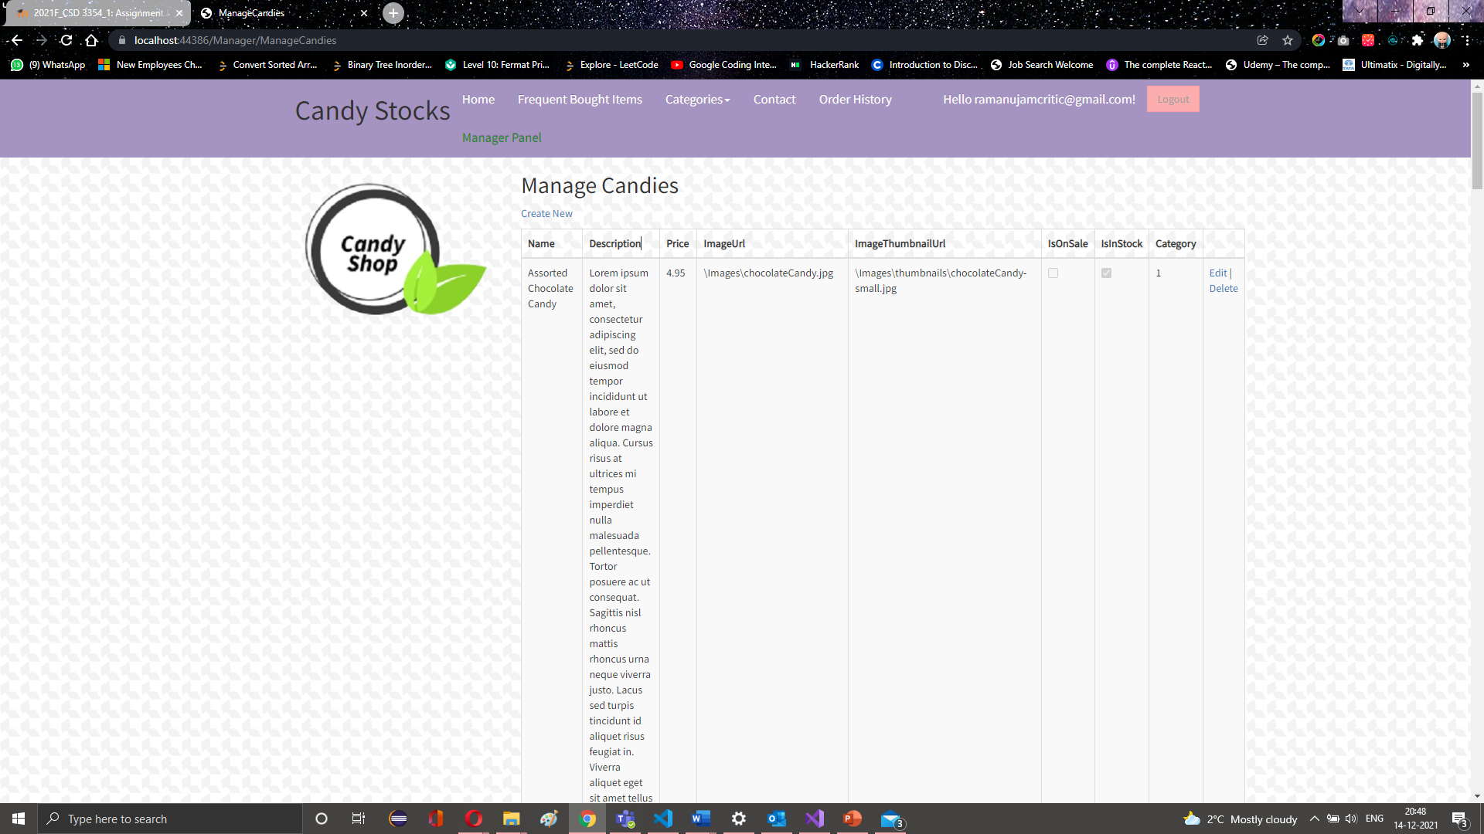
Admin Panel -> Manage Stocks
Admin user or manager user shall be able to view all the stocks that are available in the system
The user shall also be able to add, edit or delete a stock to system

Slide 18
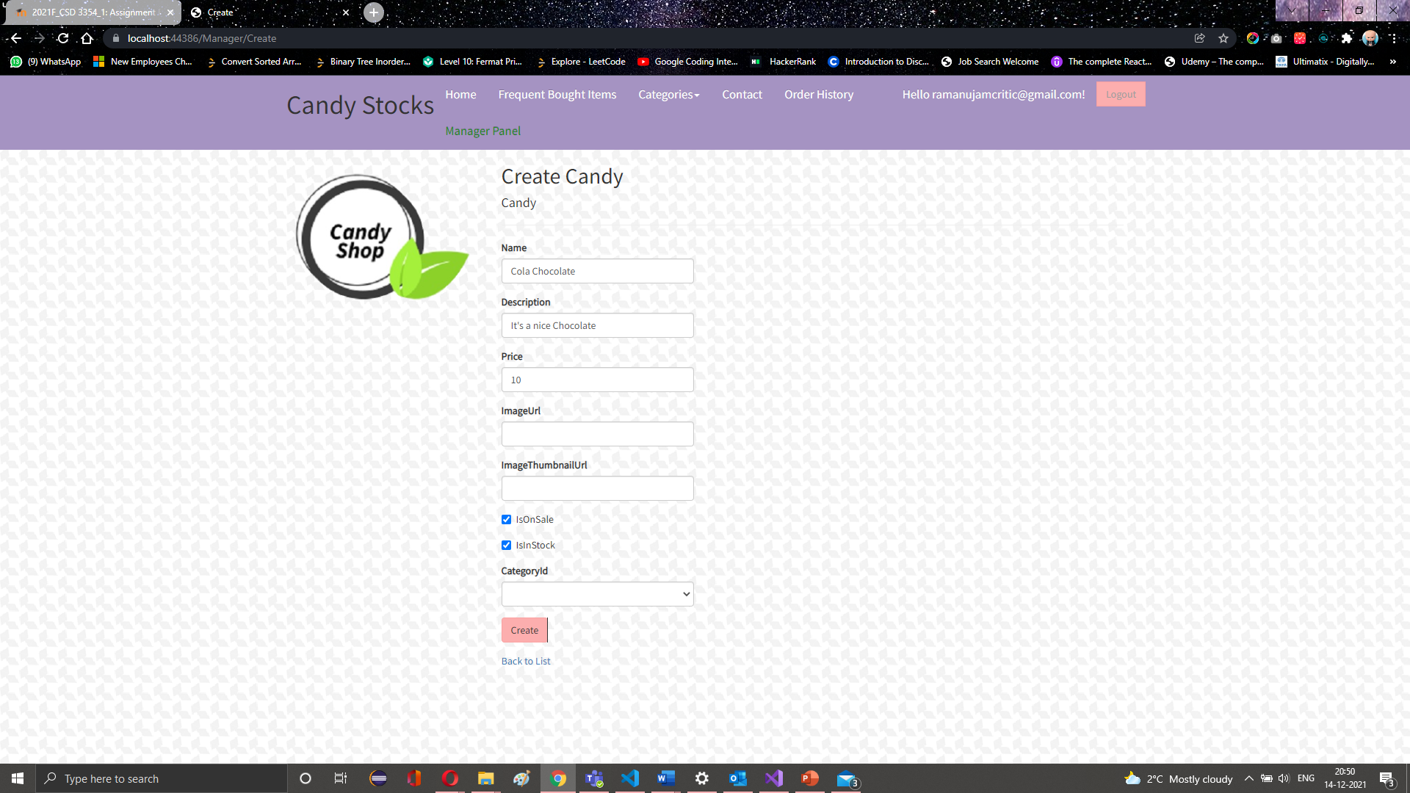
Admin Panel -> Manage Stocks-> Add new Stock
Admin user or manager user shall be able to add a new stock to the system by clicking the create new option provided in the manage stocks page.
User shall be able to key in all the information and add the new stock to the system

Slide 19
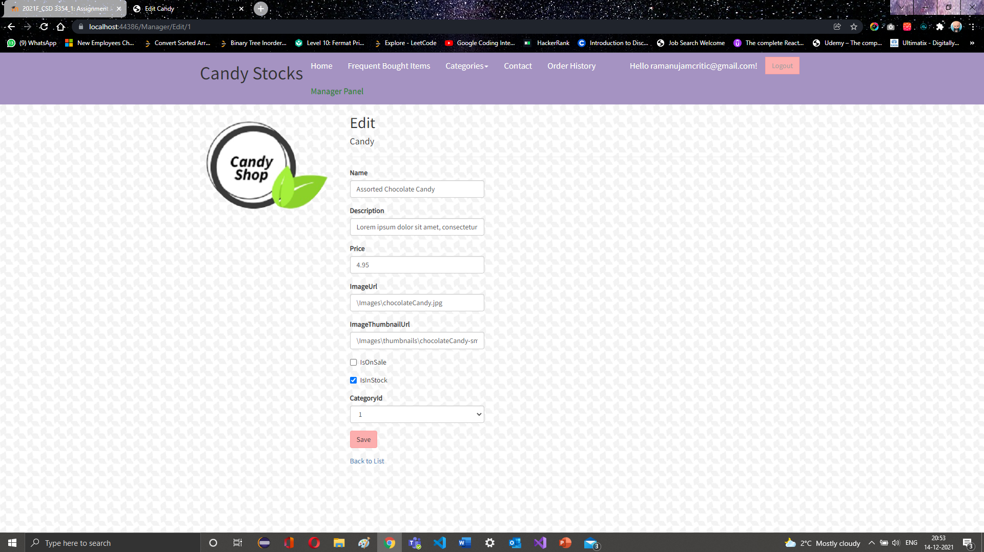
Admin Panel -> Manage Stocks-> Edit Stock
Admin user or manager user shall be able to edit a stock in the system by clicking the edit option provided in the manage stocks listing page.
User shall be able to key in all the information and save the edited stock to the system

Slide 20

Admin Panel -> Manage Stocks-> Delete Stock
Admin user or manager user shall be able to delete a stock to the system by clicking the edit option provided in the product list page.
Deleted stock cannot be recovered as it is a hard delete.

